Slide 1


Hotel Aggregator Analysis using Power BI
This presentation provides a comprehensive analysis of a hotel aggregator's data using the powerful data visualization tool, Power BI. It covers key aspects of the analysis, from data sources and preparation to exploration, performance indicators, and final insights and recommendations.
Ua
by UDIT TYAGI

Slide 2
Introduction
1
Overview
2
Objectives
3
Scope
This analysis aims to uncover valuable insights from the hotel aggregator's data to support strategic decision-making and drive business growth.
The key objectives include identifying performance trends, understanding customer preferences, and providing actionable recommendations to enhance the aggregator's service offerings.
The analysis covers data from the past two years, focusing on hotel booking patterns, revenue streams, and customer demographics.

Slide 3
Data Sources and Preparation
Data Sources
Data Cleaning
Enrichment
The analysis utilizes data from the hotel aggregator's booking platform, customer relationship management system, and third-party market research reports.
The raw data was cleaned, transformed, and consolidated to ensure consistency and accuracy for the analysis.
Additional data points, such as customer demographics and location information, were incorporated to enhance the depth of the analysis.

Slide 4
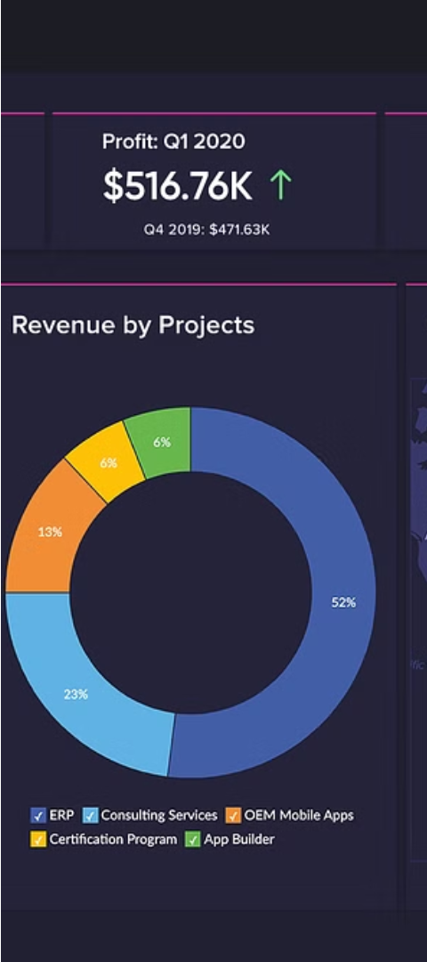
Exploratory Data Analysis
1
Booking Trends
Analyzed patterns in hotel bookings, including seasonal variations, peak periods, and changes in booking volume over time.
2
Customer Segments
Identified key customer segments based on factors such as travel purpose, budget, and preferred hotel amenities.
3
Market Insights
Benchmarked the hotel aggregator's performance against industry trends and competitors to gain a comprehensive understanding of the market landscape.

Slide 5
Key Performance Indicators
Booking Conversion Rate
Average Daily Rate (ADR)
Measured the percentage of website visitors who successfully completed a hotel booking transaction.
Tracked the average price per room, a crucial metric for optimizing revenue management strategies.
Customer Satisfaction
Revenue per Available Room (RevPAR)
Analyzed customer ratings and reviews to gauge satisfaction levels and identify areas for improvement.
Calculated the revenue generated per available room, providing insight into the aggregator's overall financial performance.

Slide 6




Visualizations and Dashboards
Trend Analysis
Customer Segmentation
Geographical Insights
Performance Monitoring
Visualized booking trends, seasonality, and growth patterns using interactive line charts and area graphs.
Depicted customer segments and their booking preferences through dynamic bar charts and scatter plots.
Leveraged geographic visualizations, such as heat maps and bubble charts, to analyze hotel demand by location.
Developed a comprehensive dashboard to track and monitor the key performance indicators in real-time.

Slide 7
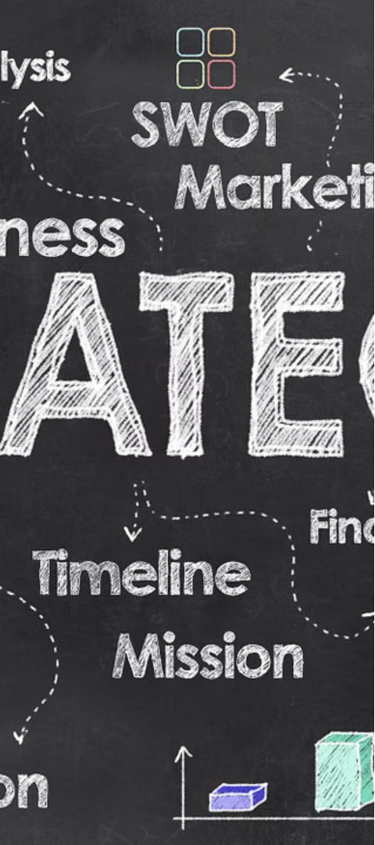



Insights and Recommendations
Optimize Pricing
Adjust pricing strategies based on demand patterns and competitor analysis to maximize revenue and occupancy rates.
Enhance Customer Experience
Identify and address pain points in the booking process to improve customer satisfaction and loyalty.
Expand into New Markets
Leverage insights on emerging travel trends and customer preferences to explore opportunities for geographic expansion.

Slide 8
Limitations and Future Improvements
1
Data Constraints
2
Evolving Trends
3
Integration Challenges
Limitations in data availability and quality may have impacted the depth of the analysis in certain areas.
The hotel industry is subject to constant change, requiring regular updates to the analysis to stay relevant.
Integrating data from multiple sources posed some technical challenges that could be addressed through system enhancements.

Slide 9
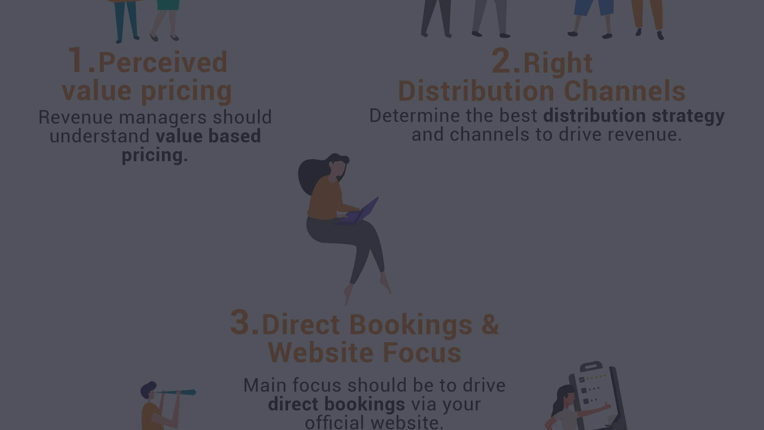
Conclusion
This comprehensive Power BI analysis has provided valuable insights to help the hotel aggregator make data-driven decisions, optimize operations, and enhance its service offerings to drive continued growth and success.

